Slide 1
Social-Emotional Learning (SEL) Curriculum

Slide 2
What is SEL and Why Does It Matter?
Notes:
NOTE: To change images on this slide, select a picture and delete it. Then click the Insert Picture icon in the placeholder to insert your own image.

Slide 3
BSD’s 2 Elementary Core SEL Curriculums
Second Step (K-2)
RULER (3-5)
Notes:
NOTE: To change images on this slide, select a picture and delete it. Then click the Insert Picture icon in the placeholder to insert your own image.

Slide 4
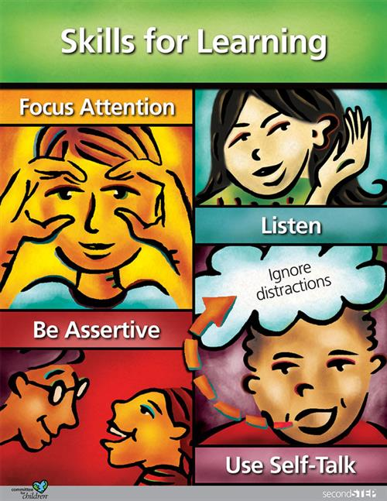
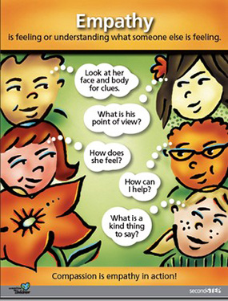
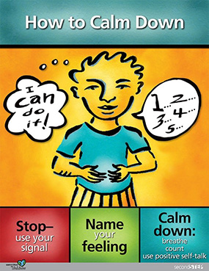
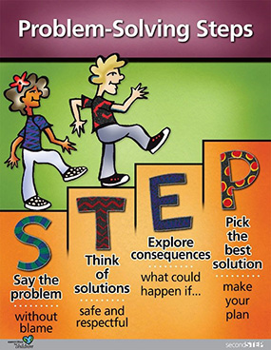
Second Step (Kinder - 2nd Grades)
4 Units per grade: (22 total lessons each year)
Skills for Learning
Empathy
Emotion Management
Problem Solving

Slide 5
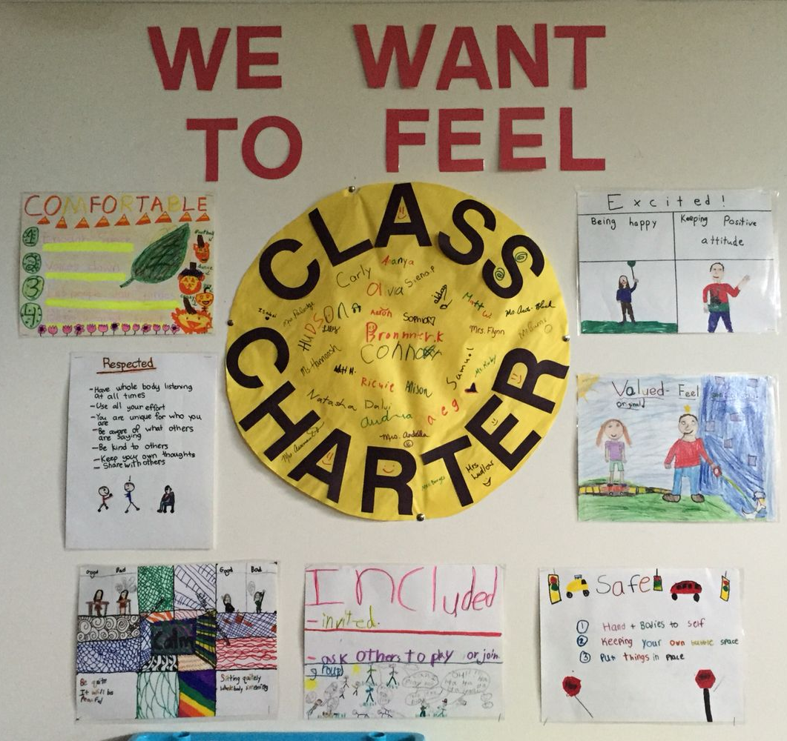
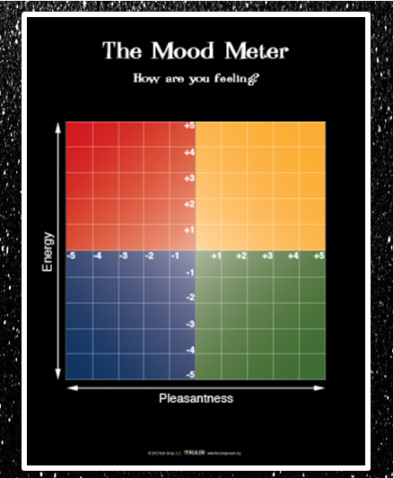
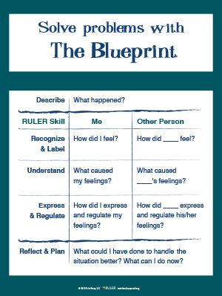
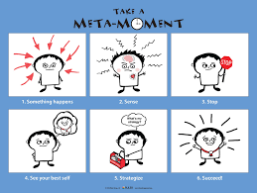
RULER (3rd - 5th Grades)

Slide 6
Additional BSD SEL-related Curriculums
Second Step’s Child Protection Unit (K-2)
Second Step’s Bullying Prevention Unit (K-5)
Notes:
NOTE: To change images on this slide, select a picture and delete it. Then click the Insert Picture icon in the placeholder to insert your own image.

Slide 7
Second Step: HomeLinks & Access Codes
Second Step SEL Curriculum:
Kinder: SSPK FAMI LY70
1st Grade: SSP1 FAMI LY71
2nd Grade: SSP2 FAMI LY72
Second Step Child Protection Unit:
Kinder: CPUK FAMI LYGK
1st Grade: CPU1 FAMI LYG1
2nd Grade: CPU2 FAMI LYG2
Second Step Bullying Prevention Unit:
Kinder: BPUK FAMI LY00
1st Grade: BPU1 FAMI LY01
2nd Grade: BPU2 FAMI LY02
3rd Grade: BPU3 FAMI LY03
4th Grade: BPU4 FAMI LY04
5th Grade: BPU5 FAMI LY05

Slide 8
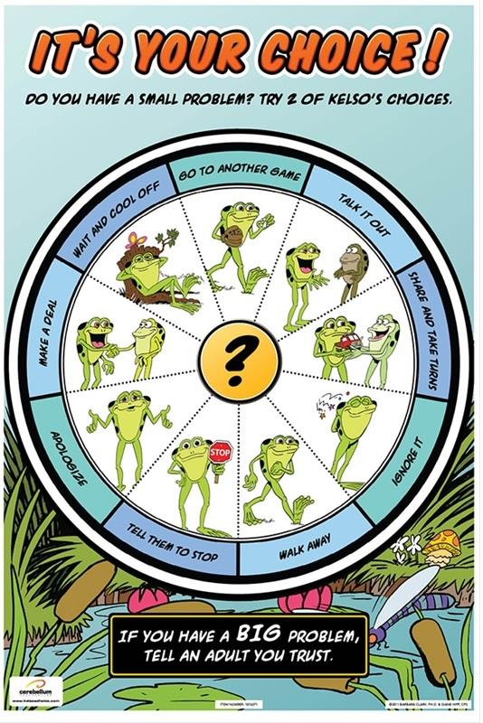
Supplemental Counseling SEL Lessons Based on Student Need
Sample Topics
Kelso’s Choices / Solving Small Problems
Appreciating Differences
I-Messages
Growth Mindset
Making & Keeping Friends
Mindfulness
Positive Self-Talk
Social Filter
Taking Responsibility
Inclusivity & Being Yourself

Slide 9
Supplemental Counseling SEL Lessons Based on Student Need
Home Communication Blurb
This week, Ms. Mykela, our School Counselor, joined our class for a lesson on positive self-talk. In this lesson, our students learned that thoughts, feelings, and behaviors are all connected! When something happens, we all can have some negative thoughts and positive thoughts about it. By choosing to listen to the positive thoughts, we can feel better and make better choices. It’s pretty powerful! In small groups, students were able to work together to match situations with possible positive self-talk, or positive thoughts, they could use. As a whole class, we shared some examples with one another and then got to brainstorm some of our own. Our students worked together to come up with positive thoughts for times they may feel worried, discouraged, embarrassed, or like they’re not good enough. Ideas included: “I’ve done hard, scary things before, and I can do it again!” “I am really good at…”, and “I can always learn from my mistakes and try again.” Here are some ways you can continue this learning at home:
Model using your own positive self-talk (by sharing it out loud around them!) when you are going through something frustrating, difficult, or challenging. They learn so much from watching the adults around them!
Next time your student is struggling with a problem, academic or with a friend or sibling, ask them what kind of thoughts would be most helpful right now. How might those thoughts be impacting their feelings and behaviors or actions?

